Slide 1


Linda Craig
Regional Lead, Patient Client Experience Programme, PHA
Chris McCann
Director, Healthwatch
Rosemary Agnew
Independent National Whistleblowing Officer
for the NHS in Scotland

Slide 2
Linda Craig
Regional Lead,
Patient Client Experience Programme, PHA

Slide 3


Exploring the Lived Experience of People in Northern Ireland
Linda Craig – Regional Lead for Regional Patient
Client Experience (PCE) Programme, PHA

Slide 4



Regional Patient Client Experience Programme
Led by PHA in partnership with HSC Trusts
AIM:
“…to proactively enable service users, families and carers to share their narrative/ stories of Health and Social Care through a mechanism which enables regional analysis and can lead to learning and change at all levels of the HSCNI system…”
Online User Feedback Service
Bespoke Projects –
Story Analysis through Sensemaker
Lived Experience of Residents within Care Homes

Slide 5
Regional Patient Client Experience Programme
Opportunities for Learning and Early Intervention
Story
Moderation
Alerts
Responses
Learning & Change

Slide 6

Context of Regional PCE Programme
Statutory Duty of Quality
Early Intervention Intelligence
Formal Complaints
SAIs
Public Inquiries
What are the Touch Points for Learning?
- to ensure high quality of treatment and care at the earliest opportunity to learn
Notes:
Early Intervention Intelligence
Regional PCE Programme
PCC Support & Advice; Advocacy Early Resolution
C&V Advocacy Roles
Personal & Public Involvement

Slide 7

Regional Patient Client Experience Programme
Opportunities for Learning and Early Intervention
Individual
Service
Organisation
Regional
Strategic
Individual responses
Collective Analysis
Organisation Governance
Regional Forums
Strategic Influence

Slide 8
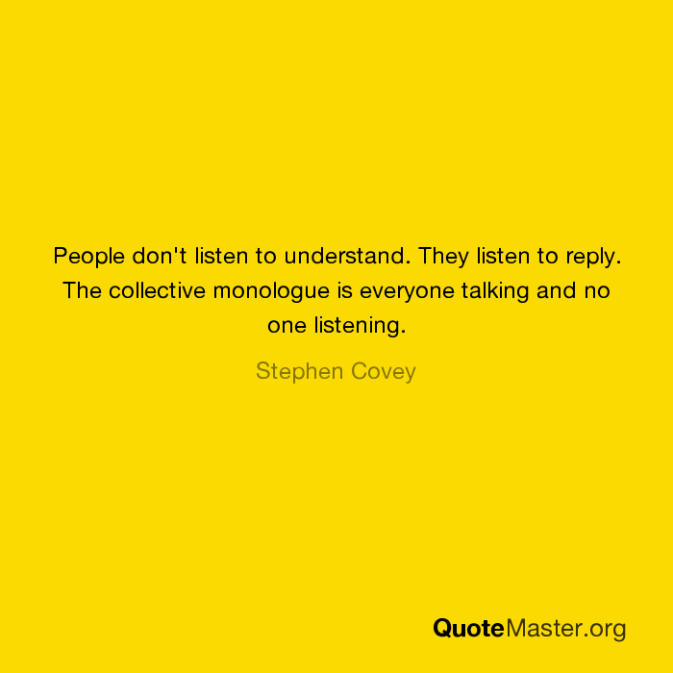
How can instil a culture of listening to the voices of people engaging our services – at all levels?
So we can identify the learning and embed it early
to ensure high quality of treatment and care

Slide 9
Linda Craig – Regional Lead PCE Programme, PHA
 linda.craig3@hscni.net
 07803133421

Slide 10
Chris McCann
Director
Healthwatch

Slide 11
Healthwatch making people’s voices count in care
Chris McCann
March 2024

Slide 12

England’s health and social care champion
We make sure NHS leaders and other decision makers hear the public’s voice and use that feedback to improve care.
We seek people’s experience of GPs and hospitals, dentists, pharmacies, care homes or other support services.
We have the power to make sure NHS leaders and other decision makers listen to your feedback and improve care.
Wherever someone lives in England, they’ll have a local Healthwatch nearby.
We’re entirely independent and impartial.
We help people the information and advice you need to make the right decisions for you.

Slide 13
Our strategy
Objectives
To support more people who face the worst outcomes to speak up about their health and social care, and to access the advice they need.
To support care decision-makers to act on public feedback and involve communities in decisions that affect them.
To be a more effective organisation and build a stronger Healthwatch movement.

Slide 14
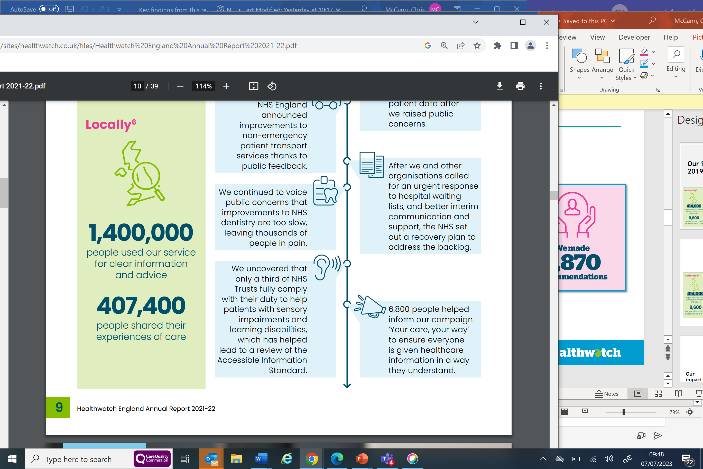
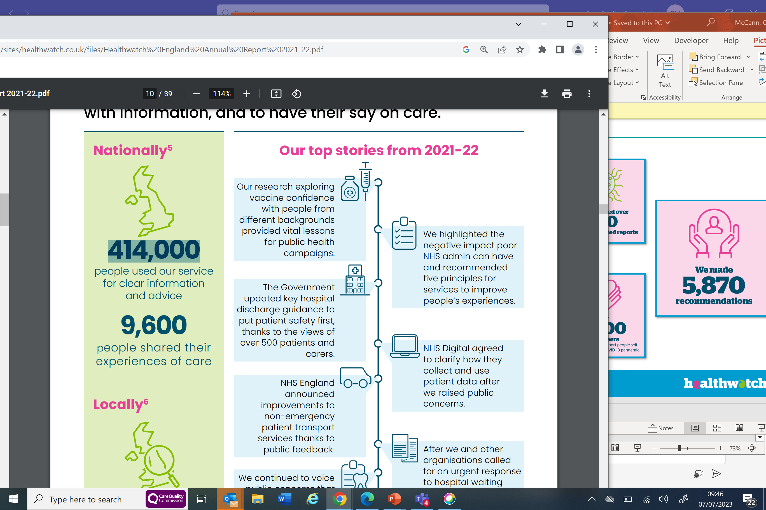
Our reach 2021-22

Slide 15
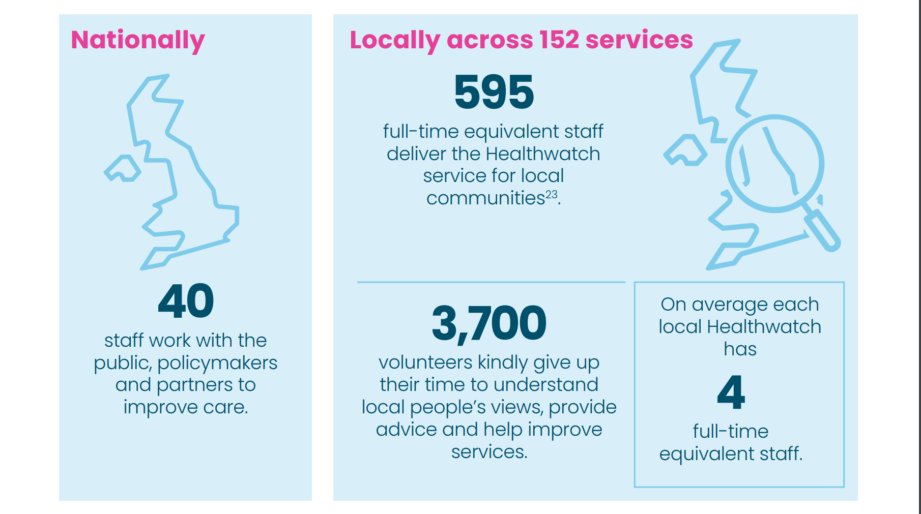
Our People

Slide 16
10 Years of delivery
2013 to 2023

Slide 17
10 Million People have been supported
3 million people have shared their experiences with us.
7 million supported through signposting and information.
So we have helped 10 million people in total.

Slide 18
Achievements 2013-23
The Accessible Information Standard - we helped inform the initial standard in 2016 and then helped review its implementation. Ultimately this led the network to keep highlighting this issue and our subsequent “your care your way” campaign resulting in the changes due this spring.
Choice on GP appointments - we secured a right for patients to always be asked if they want a face to face or digital appointment with their GP.
The NHS long term plan - Between March and June 2019, the Healthwatch network carried out 500 focus groups, attended 1,000 events and engaged 40,000 people online to find out what people wanted from the next ten years of the NHS.
Positive changes to patient transport support – for people physically unable to travel, can’t afford transport, or live in a rural area, getting to your GP or hospital appointment can be next to impossible. Without help, some people risk missing vital care like chemotherapy or dialysis. We helped improve non-emergency patient transport services. The NHS introduced new, clear, and consistent eligibility criteria for support.

Slide 19
Achievements 2013-23
The work we did during COVID-19 - In the initial wave of the pandemic from April to June 2020 alone we provided insight from the feedback over 19,000 people we received on: primary care; secondary and urgent care; mental health services; social care; and community and other services – including patient transport, equipment services and charitable or voluntary services such as the National NHS Responder Scheme, and more.
Fairer NHS dentistry - People across the country have told us they can't find an NHS dentist, and paying for dental care is a struggle, leaving them in pain. This issue has hit people on low incomes hardest. We are determined to keep this issue front and centre. Our work to highlight public concern has received widespread media coverage and helped to secure changes to the NHS Dental contract.

Slide 20
Addressing inequalities
Ensure that all our research, policy and communications work are designed to deliver impact that addresses issues relating to EDI.
Ensure we continue developing an evidence base that focuses on demographics and geographic spread to reflect the communities we represent accurately.
Involve more people from affected communities in our work and form partnerships to help make change happen.
Ensure that our communications are accessible and successfully reach the audiences we are trying to target.
Support local Healthwatch to build the skills and evidence they need to challenge local health and care decision-makers to improve EDI.
Foster a workforce culture that promotes and embraces EDI and demonstrates exemplary practices around equity.

Slide 21
Health Disparities: waiting for planned care
Our research highlighted that these challenges are not always experienced equally across all patient groups and a poor experience of waiting is linked to wealth, disability, education, gender or ethnicity.
Disabled people, those with lower levels of wealth, women, and people from ethnic minority backgrounds are the most likely groups to have been waiting over four months for treatment and to have experienced a delay or cancellation. And when we combine identities, for example, by looking at responses from people from an ethnic minority background with lower wealth and comparing their experiences to people from a white British background with higher wealth.
People from ethnic minority backgrounds respondents with lower wealth (63%) are more likely to have had their treatment delayed or cancelled than people from white British backgrounds with higher wealth (38%
Women and disabled people are also most likely to have been negatively impacted by their long wait for care, with relationships, socialising, ability to provide care for a loved one, and mental health and wellbeing suffering as a result.
People with lower levels of education are more likely than people with higher education to be happy with the information the NHS has provided them. And though some disparities are clear to see, others require a more nuanced look at identities and characteristics for us to understand the barriers different people face.

Slide 22
The importance of intersectionality
Taken independently, ethnicity, disability, wealth, education or gender won’t explain all the barriers someone might face 100% of the time. Often, factors can combine to show a worse experience for people with multiple protected characteristics.
We looked at the ethnic and wealth disparities in the experience of hospital delays or cancellations. When we combine those indicators and look at ethnicity and wealth together, the differences are even more pronounced. •
People from ethnic minority backgrounds respondents with lower wealth (63%) are more likely to have had their treatment delayed or cancelled than people from white British backgrounds with higher wealth (38%).

Slide 23
Holding ourselves to account on addressing Health Inequalities
Public statement on commitment to tacking health inequalities
Publish annually an EDI plan that sets out how our business plan for that year will focus on health inequalities
Report to our national committee at quarterly committee meetings on how we are performing against this plan
Publish an annual report of where our work has made a difference on health inequalities
Carry out a rolling programme of EDI training for Healthwatch staff

Slide 24
Listening is integral to improving quality of care
When informed by the views and experiences of those who use them services can harness user insights to improve the quality of care and design services that deliver what people need, not what professionals think they need. But this requires a culture of openness. But, above all, listening to patients and their loved ones is key to safety.
From the frontline upwards, staff are open to learning from every conversation with patients.
People's concerns and complaints are viewed as an early warning system to highlight safety issues, and organisations are open to acknowledging problems and learning from them.
Services that provide joined-up care, whether run by the NHS, local government or the third sector, are open to pooling their insight to understand how people feel about their support overall and where barriers exist.
Those who plan long-term services are open to listening to the views of every community about what they want from future services and working with them to make change happen.

Slide 25
Thank-you
chris.mccann@healthwatch.co.uk

Slide 26
Rosemary Agnew
Independent National Whistleblowing Officer
for the NHS in Scotland

Slide 27
NIPSO Patient safety Conference 20 March 24
INWO – an introduction
Rosemary Agnew
Scottish Public Services Ombudsman and Independent National Whistleblowing Officer for the NHSS

Slide 28

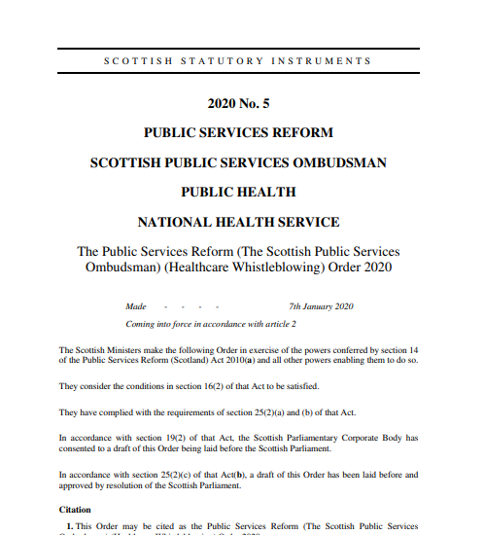

History

Slide 29
Investigation
Handling / compliance
Standards
Effect of statute
Oversight
Detriment
Action taken
Model complaint handling
Compliance
Culture
Monitor
Advise
Report
Public Services Reform (The Scottish Public Services Ombudsman) (Healthcare Whistleblowing) Order 2020
SPSO Powers and Duties
13/09/2024

Slide 30
Overview of W/B journey to INWO
BAU
Stage 1
Stage 2
INWO

Slide 31
Overview of W/B journey with INWO
Enquiry
Initial assessment
Investigation
Report or delegated decision

Slide 32
Stats only part of the story …
 |  | All cases received
 |  | Case numbers |  | Difference in cases compared to same quarter, previous year
 |  | Quarterly | YTD | Quarterly | YTD
21/22 | Q4 | 26 | 114
22/23 | Q1 | 26 | 26
 | Q2 | 33 | 59
 | Q3 | 29 | 88
 | Q4 | 42 | 130 | 16 | 16
23/24 | Q1 | 34 | 34 | 8 | 8
 | Q2 | 32 | 66 | -1 | 7
 | Q3 | 26 | 92 | -3 | 4

Slide 33
Challenges and opportunities
There was little or no meaningful data
Primary care (GPs, dentists, pharmacists)
More complex investigation
Expectations – understandably high
Trust and confidence
Framing the concern
  HR
  Patient safety
  Speak-up culture
  Detriment

Slide 34

Emerging learning
Communication is key – at every stage and beyond
Contracted services
Senior staff
Role of N.E.D./ whistleblowing champions
Investigations about culture – in particular in relation to patient safety
Impact of speak up week

Slide 35
Patient safety – challenging the concept
Patient Safety
Staff
Treatment
Governance
Support Services
Management

Slide 36

Questions

