Slide 1


Breakout 3
Implementing an Effective Learning Culture
Sean Martin - Deputy Ombudsman, NIPSO
Prof Annette Boaz - Kings College, London

Slide 2
Sean Martin
Deputy Northern Ireland Public Services Ombudsman

Slide 3
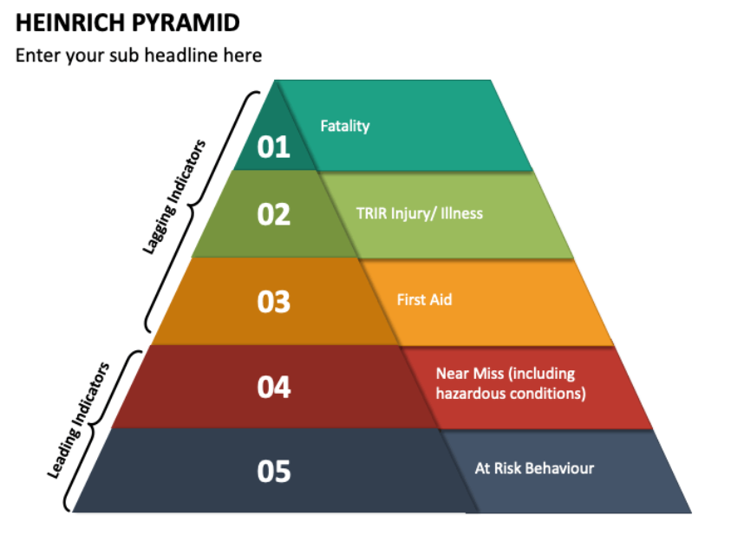
Heinrich Pyramid

Slide 4
NIPSO Research Findings
Only 30% of people who had received a poor public service complained
Of those that complained 60% reported the issue remained unresolved
Main reason for not complaining, wouldn’t make a difference
Some reported concern about repercussions
General feeling responses were not open and honest
Senior leadership support and a culture that values complaints critical to learning

Slide 5
Learning From Complaints NIPSO Review
Leadership and Culture
Obtaining Service user feedback
Recording, Analysing and Reporting
Implementation/Improvement
Dissemination
Evaluation

Slide 6
Leadership and Culture
Embed a culture of learning
Promote the benefits of a learning culture to
  drive improvement
  motivate staff
  Increase public trust
Learning culture underpinned by a committed leadership
Leadership actively involved in complaints and learning
Complaints procedures support a ‘just culture’
Use outreach, patient forums and complaint clinics

Slide 7
Complaints and Service User Feedback
Develop an integrated approach involving triangulation
Use both quantitative and qualitative methods to capture feedback
Embed service user participation during complaints process
Use a co-production approach in collection and feedback of data

Slide 8
Recording Analysing and Reporting
Data analysis and reporting strategy
Utilise a centralised system
Dedicated analytics staff
Consistent and standardised approach within organisations and across the sector
Regular and systematic review to identify key themes and patterns
Collate demographic data from complaints including
  age
  gender
  disability
  sexual orientation
  ethnicity
Undertake analysis to identify gaps in above data and address where identified

Slide 9
Implementation and Improvement
Improvement plan and governance framework
Complaints analysis reports, and user feedback at SMT and Board
Clear processes to capture and monitor commissioned services
Share learning from complaints with staff/practitioners
Provide tools, time and training to implement change
Share learning with key external groups
Seek feedback from complainants on your complaints process to inform learning and improvement

Slide 10
Dissemination
Strategy in place to share learning with;
  complainants
  service users
  staff
  other organisations
  wider public
Keep complainants informed of improvements as a result of their complaint
Make information about improvements available and accessible
Clear reporting on complaints outcomes

Slide 11
Evaluation
Evaluation framework
  Complaints management system
    are complaints used to learn and drive improvement
    are complaints and concerns listened to improve quality
    how is learning shared to prevent recurrence
    are arrangements in place for recording, tracking analysing and reporting on complaints
    is analysis of trends conducted to identify possible systemic issues
    are improvements as a result of complaints publicly acknowledged
Measuring the impact of learning from complaints
  system wide learning as well as individual areas
  improvements in quality and safety as a result of the learning

Slide 12
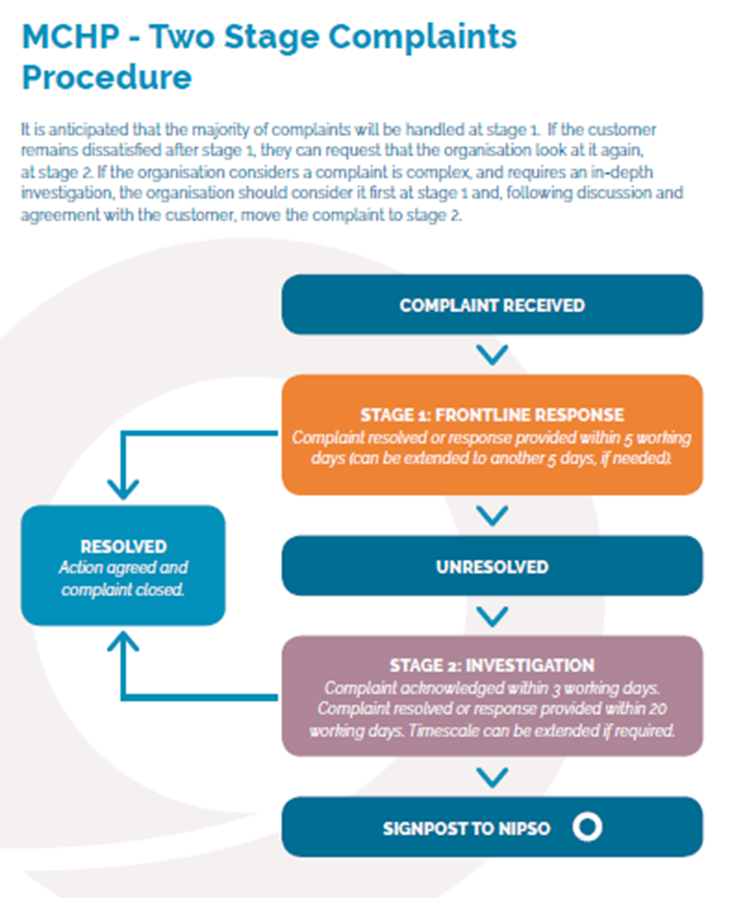
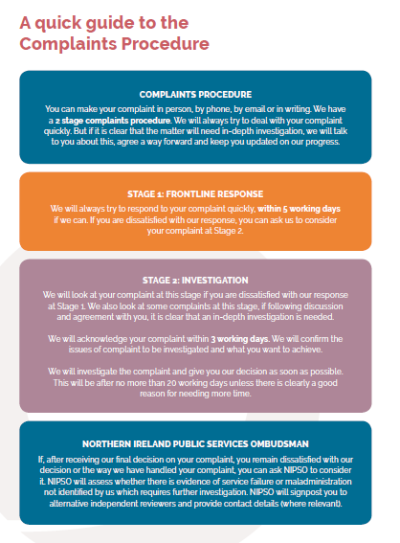

Slide 13
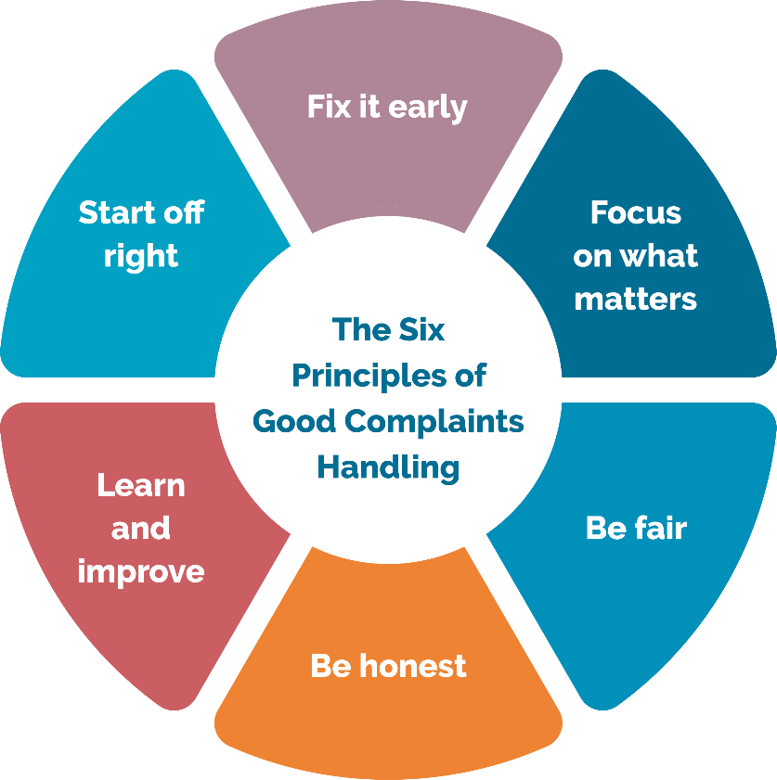

NIPSO Statement of Complaint Handling Principles

Slide 14
Aims of NIPSO’s Complaint Standards Approach
Change the culture regarding complaints
Patients and families partners in the process
Less about timescales and numbers more about learning & Improvement.
Resolution encouraged but information captured
Investigation independent and fair to all
Focus on system issues and not only individual failings
Collection and analysis of data including sharing externally
Reporting to all levels including leadership team and Trust Board
Public reporting on learning & improvement in addition to numbers and timescales
Commitment to Equality, Diversity and Inclusion

Slide 15
Prof Annette Boaz
Kings College, London

Slide 16

IMPLEMENTING AN EFFECTIVE LEARNING CULTURE
Professor Annette Boaz, 20TH March 2024
Notes:
This keynote will draw on learning from evidence-based medicine, implementation science, knowledge mobilisation, evidence informed health policy and the use of research evidence to explore what we know about supporting evidence informed change. It will cover both the facilitators and the barriers at the individual, organisational and systems levels to consider that needs to change to support evidence use. In making the case, the presentation will draw on research (including two new systematic reviews) and also insights from work undertaken to support evidence use in the UK government.

Slide 17
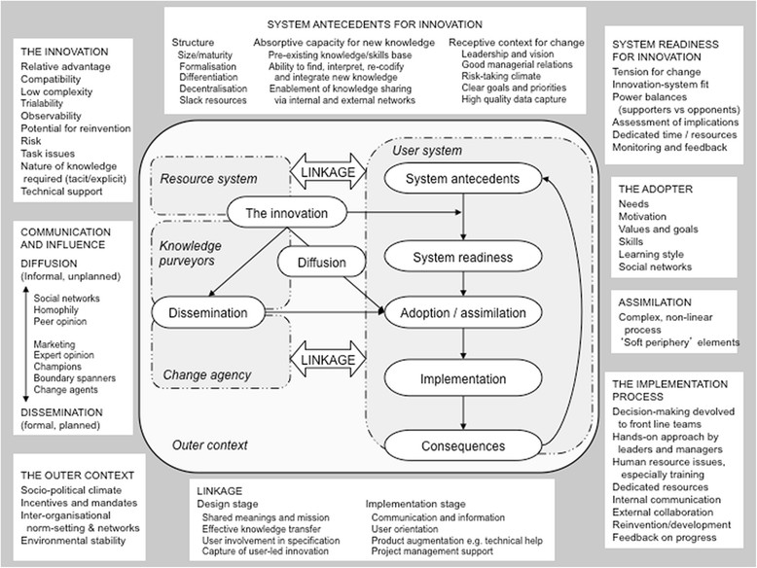
There are many challenges to building an effective learning culture…
Notes:
How many times in an evaluation do people point to ‘external factors’ - context

Slide 18
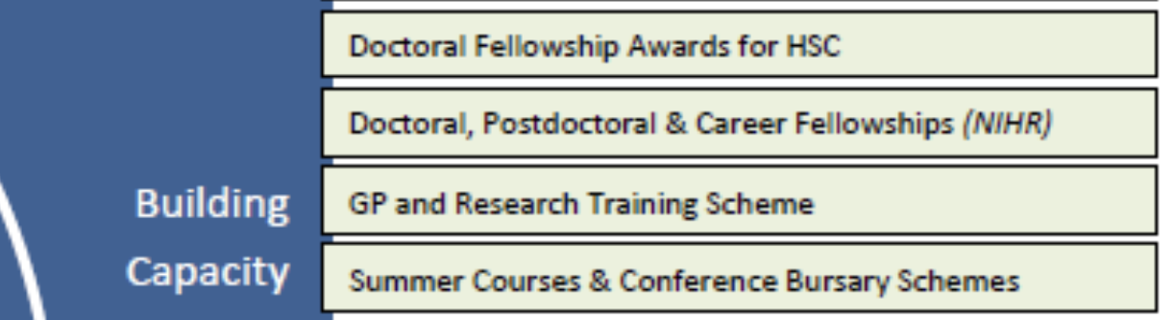


Opportunities for individuals
Kumpunen S, Matthews J, Amuthalingam T, et al Workplace-based knowledge exchange programmes between academics, policy-makers and providers of healthcare: a qualitative study BMJ Leader 2024;8:15-19.

Slide 19

How do organisations use the new capacities of their staff?
Resistance individuals experienced returning to the workforce:
Managerial
Medical
Organisational
Interprofessional
Fletcher, Simon; Whiting, Cheryl; Boaz, Annette; Reeves, Scott; (2020) Expanding postgraduate clinical research capacity: an exploration of key resistances. Journal of further and higher education, 44 (5). pp. 596-608. ISSN 0309-877X DOI: https://doi.org/10.1080/0309877x.2019.1571173
Notes:
Compounded by use of fellowships, internships etc – only work if org can be receptive to new skills/ indiv development

Slide 20
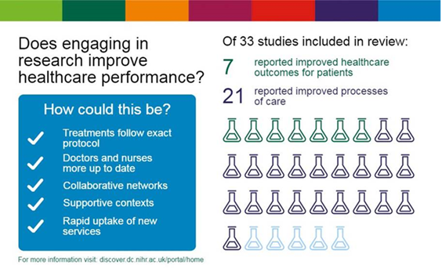
What happens if we build research engagement into healthcare organisations?
Notes:
Growing lit also looking at the importance of interorg networks

Slide 21

Lower mortality and research active hospitals
The study: Used >200 000 colorectal cancer (CRC) patients to test hypothesis that high, sustained hospital-level participation in interventional clinical trials improves outcomes for all patients with CRC managed in those research-intensive hospitals
The results: Patients treated in hospitals with high rates of research participation (≥16%) in their year of diagnosis had lower postoperative mortality and improved 5 year survival: 3.8% (41.0%-44.8%, p<10⁻¹⁹)
“The effects...not restricted to academic centres or hospitals with large practices... [also] higher rates of participation...showed a ‘dose effect’”
Downing A, Morris EJA, Corrigan N, et al. (2017) High hospital research participation and improved colorectal cancer survival outcomes: a population-based study. Gut;66:89–96: doi:10.1136/ gutjnl-2015-311308

Slide 22
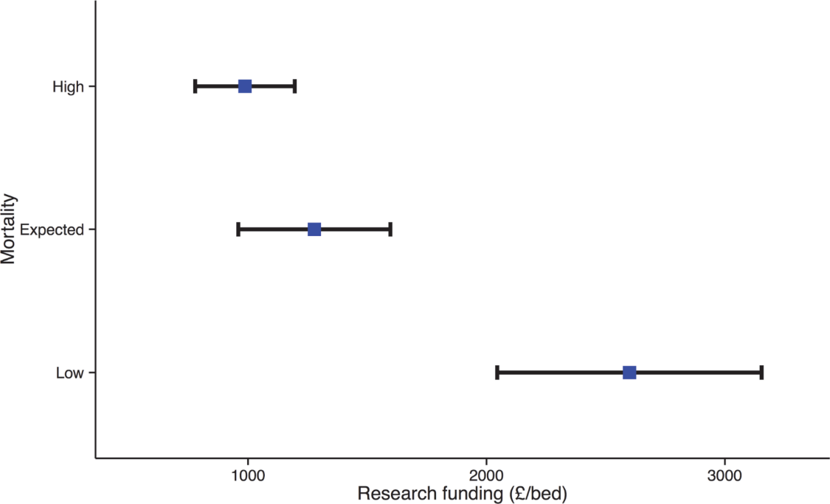
Lower mortality and research active hospitals
NIHR Comprehensive Clinical Research Network (CCRN) funding (£/bed) in English acute NHS Trusts - Trusts sub-grouped as low (n = 35), as expected (n = 63) and, high (n = 42) mortality. For each group, the mean and 95% CI funding are shown.
“Research active Trusts had lower risk-adjusted mortality for acute admissions, which persisted after adjustment for staffing and other structural factors”
Source: Ozdemir BA,..Boaz A et al. (2015) Research Activity and the Association with Mortality. PLoS ONE 10(2): e0118253. doi:10.1371/journal.pone.0118253

Slide 23
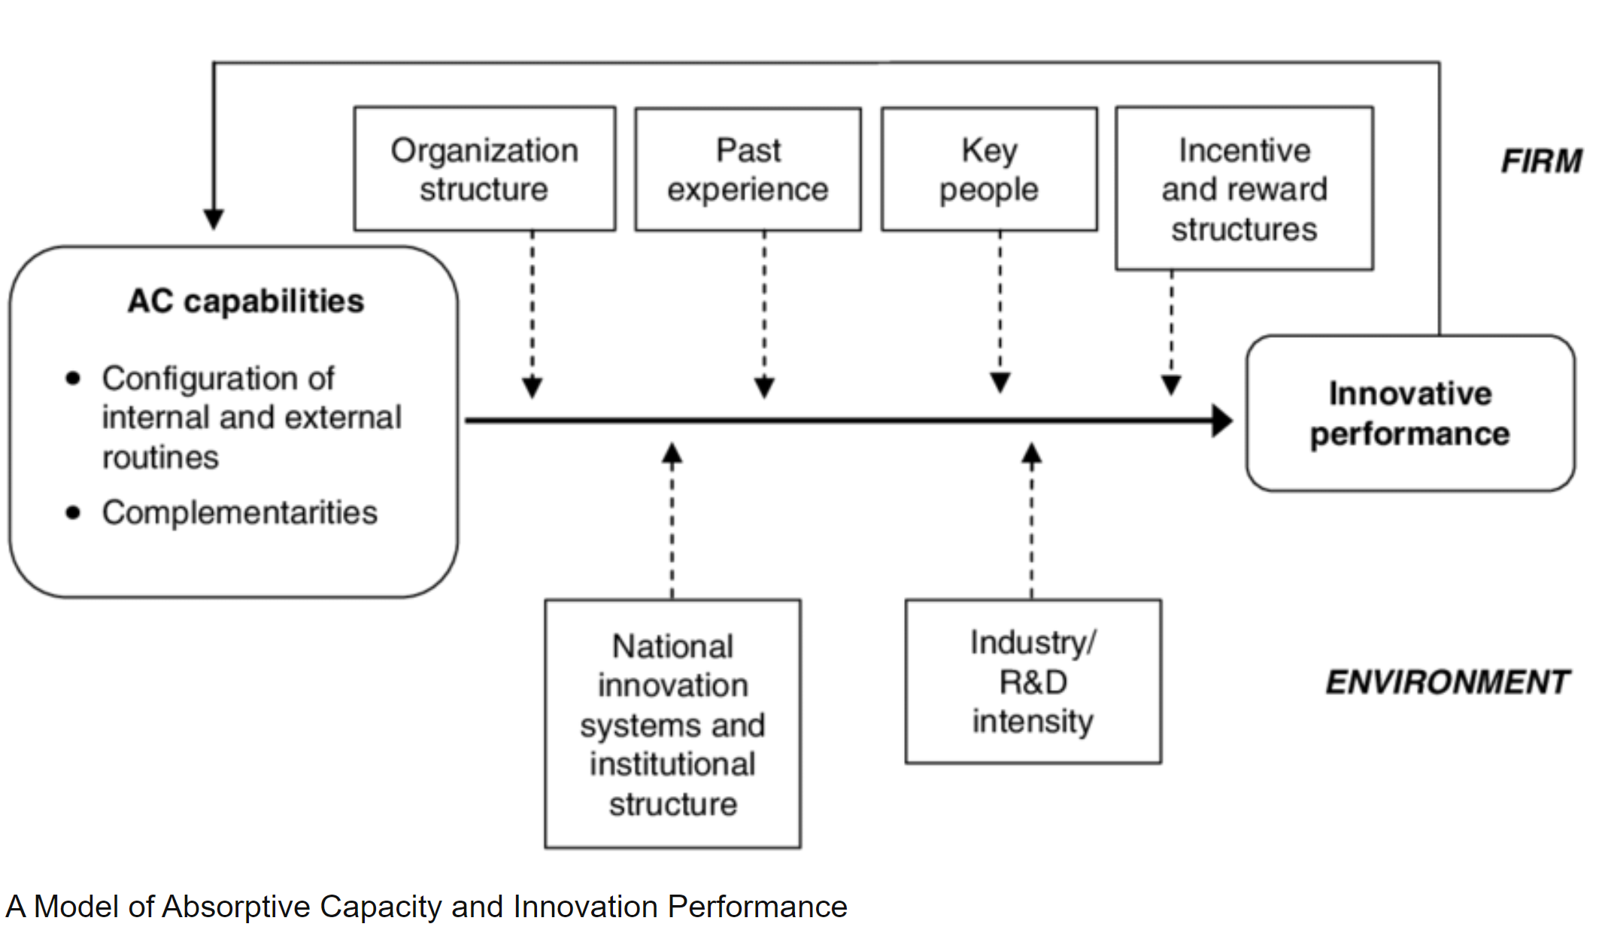
How do we build learning cultures?
Notes:
Its about people and organisational structures and external elements that drive change

Slide 24

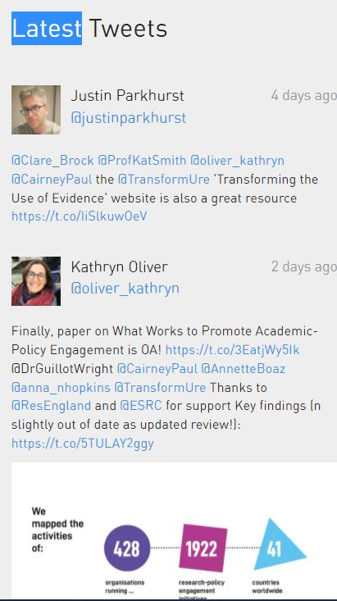
Thank you
Transforming Evidence (transforming-evidence.org)
@transformUre
@AnnetteBoaz
Annette.Boaz@kcl.ac.uk

Slide 25
Q & A and Discussion
Facilitator – Dr Jennifer Hanratty

