Slide 1


Margaret Kelly
NI Public Services Ombudsman
Opening Address
Sir Robert Francis KC
Keynote Speaker

Slide 2
Margaret Kelly
NI Public Services Ombudsman

Slide 3
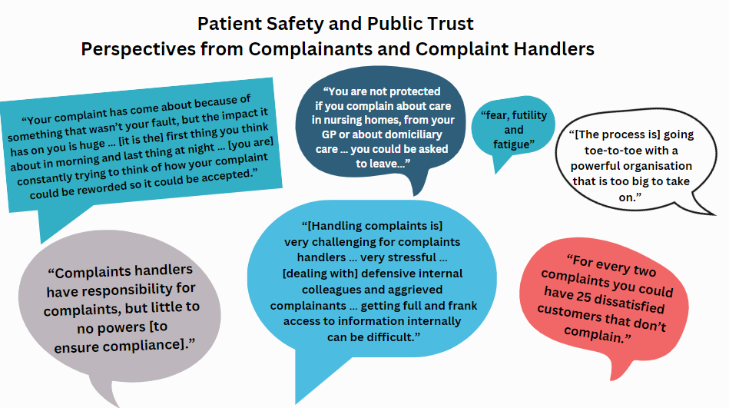

Slide 4
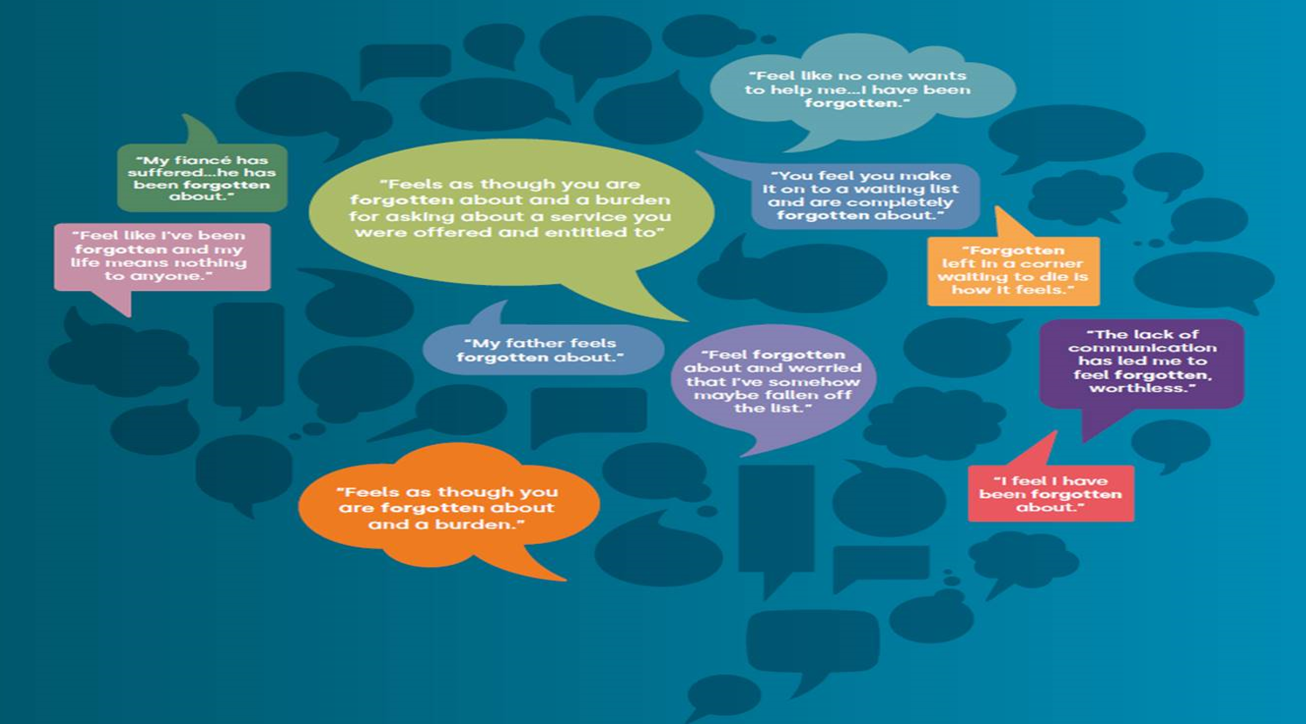

Slide 5
Why Patient Safety and Public Trust Focus Now?
Levels of Satisfaction falling
Another Public Inquiry
Unprecedented Pressure
Falling Behind Other Jurisdictions
Opportunity!

Slide 6
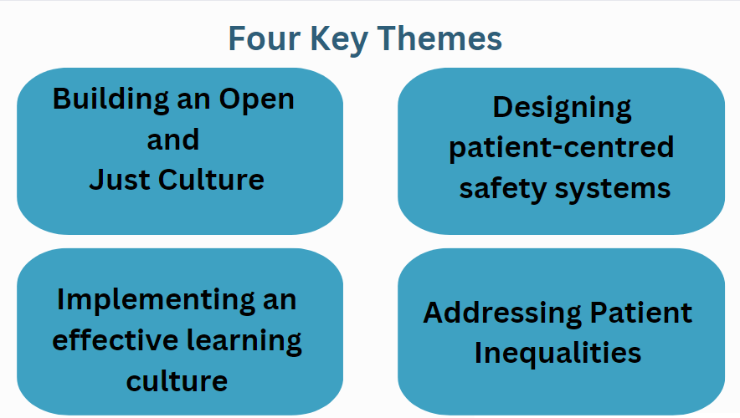

Slide 7
Sir Robert Francis KC
Keynote Speaker

Slide 8

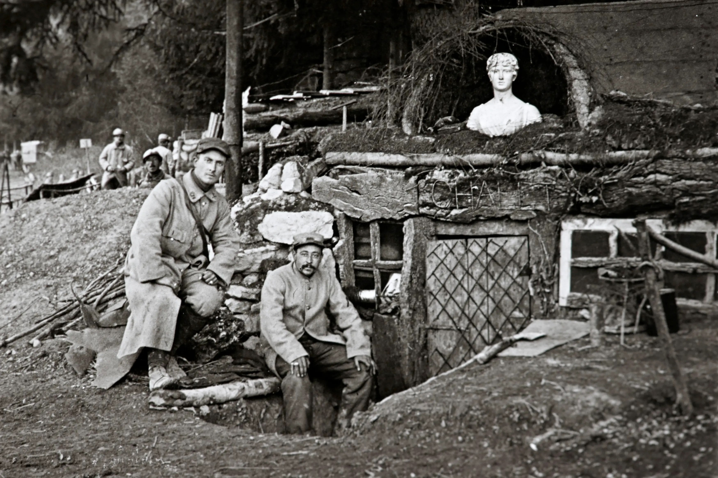


LEARNING FROM INQUIRIES
Reflections from the front line
PATIENT SAFETY CONFERENCE 2024
Belfast 20 March 2024
Sir Robert Francis KC
Serjeants’ Inn Chambers
London EC4Y 1AE
Notes:
WHAT I WILL TALK ABOUT
WHY ME AND WHY THIS SUBJECT?
PURPOSE OF INQUIRIES
PITFALLS
\SOME LESSONS FROM INQUIRIES
LESSONS FOR LEADERSHIP
THE REALITY FOR REAL PEOPLE WHEN SYSTEMIC THINGS GO WRONG
IMPORTANCE OF VALUES
IMPORTANCE OF CANDOUR AND OPENNESS
FREEDOM TO SPEAK UP FOR STAFF
MEASURING MANAGEMENT
QUALITY IMPROVEMENT
A FEW FINAL THOUGHTS

Slide 9
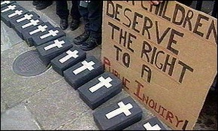
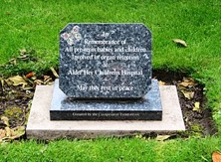
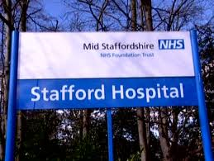
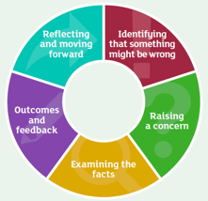
WHY ME?
Welcome to my world
Clinical negligence - inquests
Professional conduct - fitness
Schizophrenic who killed policeman detained for life
2005
Bristol Children’s Heart Surgery
Care and treatment of Peter Bryan and Richard Loudwell
Care and treatment of GB
Children’s Organ Retention at Alder Hey
Mid-Staffordshire
NHS Foundation Trust
Freedom to Speak Up
Notes:
Some of my experience of things going wrong in health services….\
NOTE THAT THEY ARE NOT ALL PUBLIC AS IN STAUTORY INQUIRIES, BUT PRINCIPLES HAVE TO BE THE SAME
SOME POINTS TO REMEMBER ABOUT INVOLVEMENT AN INQUIRY
THE BEST WAY TO AVOID AN INQUIRY IS TO PREVENT DISASTER IN THE FIRST PLACE – SO SOME LEADERSHIP LESSONS DERIVED FROM INQUIRIES
- SEEK OUT AND CONFRONT REALITY RATHER THAN HIDE IT OR FROM IT
- IDENTIFY AND LIVE BY DEFINED VALUES
- INSIST ON CNADOUR AND TRANSPARENCY

Slide 10
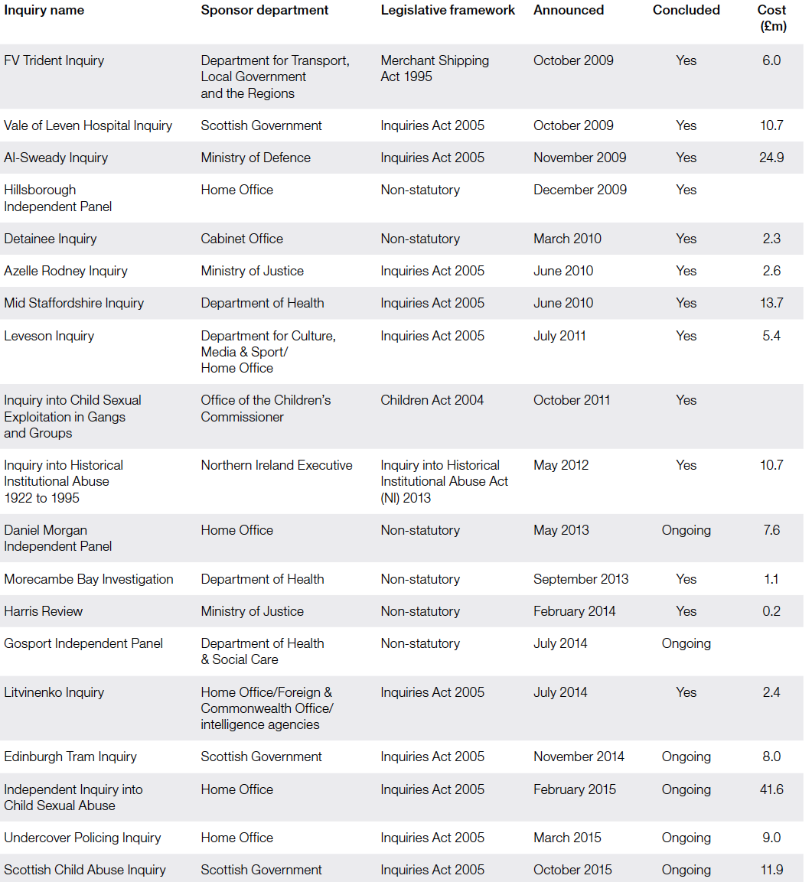
Publicly funded inquiries 2005 - 2018
19 inquiries
£239m on 20 inquiries concluded 2005-2018
Source: NAO Investigation into government-funded inquiries 2018

Slide 11


DOMINIC LAWSON: The Covid Inquiry has cost us £100 million already. I fear it will end up satisfying very few - except for the lawyers running the show
Sixty barristers and a £14m annual budget – but Covid Inquiry could still drag on until 2026
Source: Telegraph online 28 June 2022
Source: Mail online 19 November 2023
Notes:
AND AS THESE CUTTINGS SHOW SUBJECT TO MUCH PUBLIC DISSATSIFACTION HOWEVER WORTHY THE AIM AND THE CHAIR.
SCOPE OF INQUIRIES IS VERY WIDE AND THERE ARE A LOT OF THEM
THEY ARE LENGTHY AND EXPENSIVE…
WIKIPEDIA LIST OF CURRENT PUBLIC INQUIRIES:
TOTAL: 19 [UK]
HEALTH 8
UK COVID:: CROSS GOVERNMENT INQUIRY RESPONSE UNITS HAVE TOTAL LEGAL COSTS TODATE OF £20,900,000 [DECEMBER 2023]; THESSE COSTS NOT INCLUDED IN INQUIRY’S OWN COSTS. - 249 FTE STAFF; INQUIRY ITSELF HAS AWARDED PRIVATE CONTRACTS WORTH £145 M ][LBC NEWS 14/12/23 AND [SAME SOURCE HAS SPENT £56 M TO DATE
THIRWALL [LETBY]
SCOTTISH HOSPITALS
SCOTTISH COVID
MUCKAMORE ABBEY HOSPITAL
LAMPARD [ESSEX MENTAL HEALTH]
INFECTED BLOOD: SPENT £28.255 IN 2022-2023 [INQUIRY FINANCIAL REPORT; £130.35 MILLION TO DATE [potential compensation costs £20billion… according to leaked reports [said by CX to be “unwelcome”!
ELIJAMAL [SCOTLAND]

Slide 12
The purpose of inquiries….

Slide 13

Purpose of inquiries
Facts – what happened?
Accountability - why did it happen and who was to blame
Lessons – what can be done to prevent it happening again?
How public inquiries can lead to change
Norris, Shepheard: Institute for Government Dec 2017
https://www.instituteforgovernment.org.uk/sites/default/files/publications/Public%20Inquiries%20%28final%29.pdf
Notes:
But what other functions can/dso they serve?

Slide 14
Other things Inquiries do or could do?
Listening to victims
Workshops/, seminars for stakeholders
  IICSA
  Mid Staffs
Reconciliation?
Mediation?
  Royal Liverpool Childrens Inquiry
Notes:
The Liverpool Inquiry did not actually include mediation but the claims of affected parents were settled as I understand it by mediation which considered a range of non financial remedies [including demand for demolition of the building in which the body parts were stored. Could an inquiry have accommodated or facilitated this process?
Settlement terms included:
£5000 PER FAMILY
APOLOGY
LIST OF STEPS TAKEN IN RESPONSE TO SCANDAL
MEMORIAL
SOLICITOR FOR FAMILIES SAID AT THE TIME:
“today's apologies were a crucial factor in settling the litigation and allowing parents to move on.
He said: "Had it not been for today's press conference, the letters of apology and the plaque to be erected at Alder Hey, the litigation would have continued for the simple reason that no amount of money could ever compensate the parents for the trauma which they have had to endure during the course of the last three and a half years."

Slide 15

Can an inquiry achieve all three aims?
Why the Covid inquiry is a farce
Instead of learning lessons from lockdowns, the hearing is more interested in knocking the stuffing out of the government…
This may be a good way of putting the decision-makers in the stocks, something the public always enjoys. But it is a terrible way to examine the complex and disputed scientific and statistical evidence.
The Times 6 November 2023
Lord Sumption, former Justice of the Supreme Court
https://www.thetimes.co.uk/article/covid-19-inquiry-farce-jonathan-sumption-7vgtxp037
Notes:
It is a challenge to combine a search for someone to blame with a search for lessons to learn –
The latter encourages defensiveness. Lot of lawyers [for parties interested in compensation] whereas the former even if successful in identifying better processes etc may leave victims dissatisfied because they have not obtained “ justice”
So ideally a balance should be sought through the terms of reference and how the inquiry is conducted.

Slide 16
Are inquiries the answer ? - Dr Kirkup is not sure
“It is too late to pretend that this is just another one-off, isolated failure, a freak event that “will never happen again”. Since the report of the Morecambe Bay Investigation in 2015, maternity services have been the subject of more significant policy initiatives than any other service. Yet, since then, there have been major service failures in Shrewsbury and Telford, in East Kent, and (it seems) in Nottingham.
If we do not begin to tackle this differently, there will be more.
Kirkup, Reading the signals - Maternity and neonatal services in East Kent – the Report of the Independent Investigation 19 October 2023

Slide 17

… and beware recommendations…..
I do not think that making policy on the basis of extreme examples is necessarily the best approach; nor are those who carry out investigations necessarily the best to do it. More significantly, this approach has been tried by almost every investigation in the five decades since the Inquiry into Ely Hospital, Cardiff, in 1967–69, and it does not work. At least, it does not work in preventing the recurrence of remarkably similar sets of problems in other places.
Caution: This report contained: 4 Key Action areas, which included 5 recommendations which had a total of 9 sub-recommendations in a chapter describing them containing 42 paragraphs….
Kirkup, Reading the signals - Maternity and neonatal services in East Kent – the Report of the Independent Investigation 19 October 2023

Slide 18
HOW SAFE IS OUR HEALTHCARE NOW?

Slide 19

1/10 PATIENTS HARMED IN HEALTHCARE
> 3 MILLION DEATHS PER YEAR DUE TO UNSAFE CARE
50% OF HARM IS PREVENTABLE;
HALF PREVENTABLE HARM DUE TO MEDICATION
PATIENT HARM REDUCES GLOBAL ECONOMIC GROWTH BY 0.7% pa

Slide 20
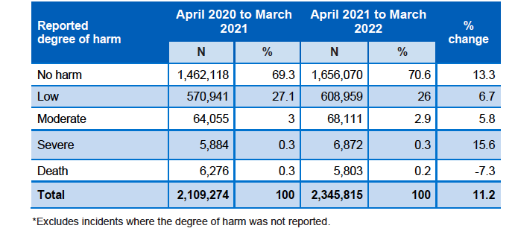
Safety incidents reported December 2003 - June 2022
Notes:
This table, giving figures during COVID suggests that the vast majority of incidents result in no harm, and only 0.5% result in severe harm or death: but that = 12.675 people.

Slide 21
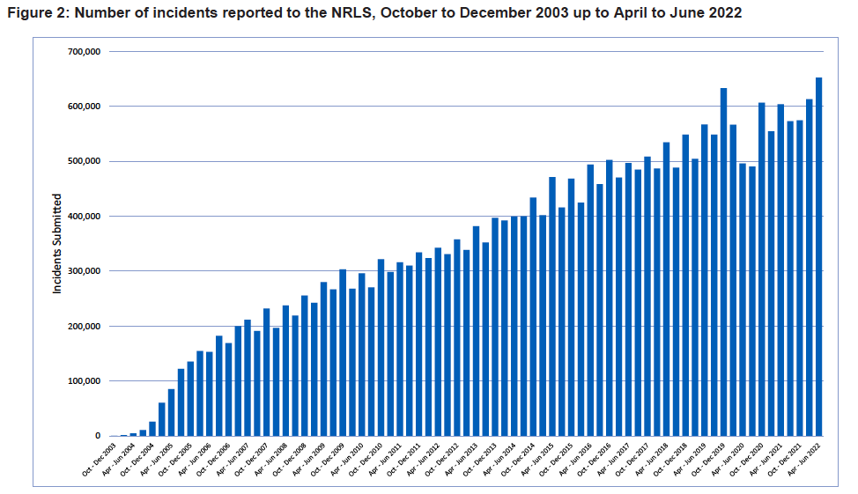
NRLS national patient safety incident reports – commentary October 2022
Notes:
… but the trend in incidents is not really encouraging even if part of hjte increase is attributable to more openness….

Slide 22
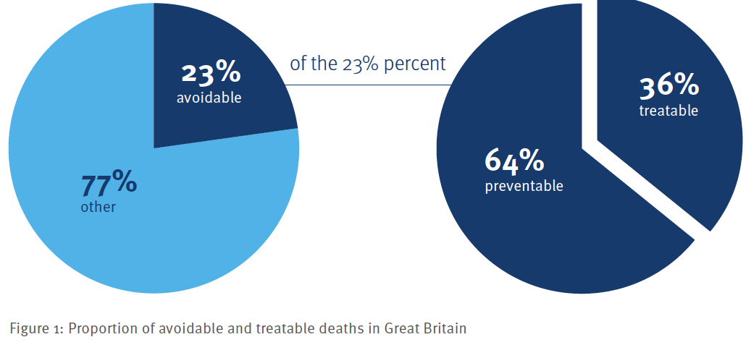
Imperial College London – Patient Safety Watch
National State o Patient Safety 2022
Avoidable deaths in GB: 130,000
% of all deaths: 22
Preventable deaths per 100,000 pop: 117.6
Treatable deaths per 100,000: 66.7
If UK matched top 10% of OECD: 21,733 preventable and 12,675 fewer from treatable causes
5% of adult hospital deaths had >50% chance of being preventable [retrospective record review]
If all NHS Trusts [England) had SHMI matching top 10% would be 32,332 fewer deaths each year between 2011-2021.

Slide 23
Healthcare culture 2023
NHS Staff Survey 2023
National results briefing
41.7% FELT UNWELL THROUGH WORK RELATED STRESS IN LAST 12 MONTHS
54.8% WORKED IN THE LAST 3 MONTHS IN SPITE OF NOT FEELING WELL ENOUGH TO PERFORM DUTIES
51.24% INVOLVED IN DECIDING ON CHANGES AFFECTING THEIR WORK
26.2% NEVER OR RARELY HAVE UNREALISTIC TIME PRESSURES: [admin/clerical staff 39.8%]
29.1% OFTEN THINK ABOUT LEAVING [best since 2020…15.7% will leave when have another job….
9.1% HAVE PERSONAL EXPERIENCE OF DISCRIMINATION BY MANAGER/COLLEAGUES [7.2% FROM PATIENTS]
10.1% bullied/harassed/abused in 12 months by MANAGERS, 18.09% COLLEAGUES, 25.7% PATIENTS/PUBLIC
51.9& such cases reported
3.8% experience unwanted sexual behaviour from colleagues in last 12 months, 8.7% from patients/public
30.4% feel burnt out because of work
33.2% staff have seen potentially harmful errors, near misses or incidents in last 12 months
59.4% FEEL THEIR ORGANISATION TREATS STAFF INVOLVED IN ERROR, NEAR MISS OR INCIDENT FAIRLY;
68.1% CONFIDENT ORGANISATION WOULD ADDRESS A CONCERN THEY REPORTED
707,460/1.4 million staff [48%]. Responded to survey

Slide 24
And in N Ireland?
Question | 2019 | 2020….2024?
Percentage of staff feeling unwell due to work related stress in last 12 months (%) | 47%
Staff attending work in the last 3 months feeling unwell because of pressure from their manager, colleagues or themselves | 61%
Staff experiencing discrimination at work in the last 12 months | 13%
Staff experiencing physical violence from staff in last 12 months | 2%
Staff experiencing harassment, bullying or abuse from staff in last 12 months [public] | 28% [32%]
Staff witnessing potentially harmful errors, near misses or incidents in last month [reporting error] | 27% [89%]
Fairness/effectiveness of reporting procedures for errors, near misses, incidents | 3.5/5
Great place to work | 48%
Action taken if physically attacked, bullied, harassed or abused effective | 31%
DH, 2019 HSC Staff Survey – Regional Benchmark Report , August 2019

Slide 25
SO WHAT HAVE WE LEARNED?

Slide 26
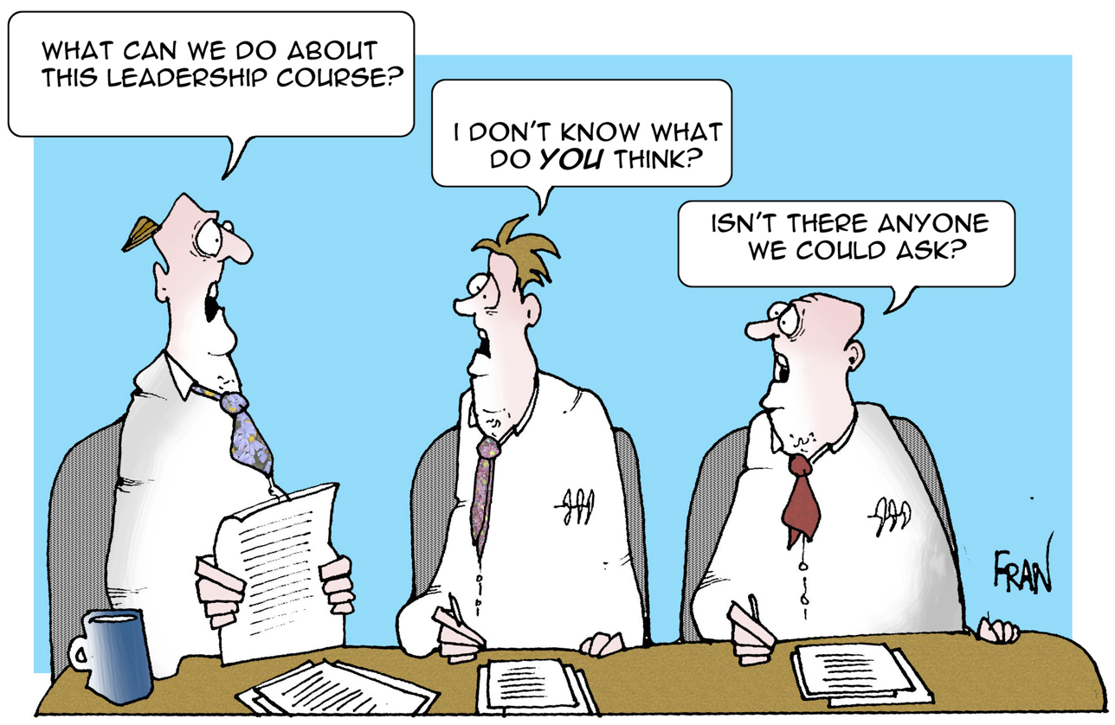
Leadership and system failures
http://sites.psu.edu/aspsy/2014/11/30/the-importance-of-good-leadership/
Notes:
A constant theme of inquiries
This is probably not a great leadership style in a criis, but collaborative, consensual leadership of course has its place.
One thing about this pictire – notice there are 3 people in – leadership principles are not just about the person at the “top” biut at all levels – in a professional service, all professionals are leaders in some way, and arguably all staff are lrafers in the sense that they can and should be empowered to take initiative.

Slide 27
The need to confront reality
Leaders know what is happening all the way to the front line
Leaders embrace and do not deny the objective truth
Leaders ensure those with discomfiting concerns are heard and protected
Leaders facilitate identification solutions to the problems, learning from failure as well as success, and review effectiveness - no solution is likely to be permanent
In all they do leaders prioritise the effect on those they serve – public but also staff - and promote the organisation’s values

Slide 28
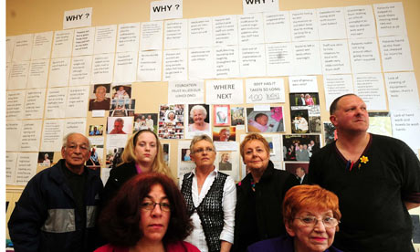
The reality for patients at Stafford
The daughter-in-law of a 96 year old patient
We got there about 10 o’clock and I could not believe my eyes. The door was wide open. There were people walking past. Mum was in bed with the cot sides up and she hadn’t got a stitch of clothing on. I mean, she would have been horrified. She was completely naked and if I said covered in faeces, she was. It was everywhere. It was in her hair, her eyes, her nails, her hands and on all the cot side, so she had obviously been trying to lift her herself up or move about, because the bed was covered and it was literally everywhere and it was dried. It would have been there a long time, it wasn’t new.
Notes:
The evidence of one daughter of a patient tells you almost all you need know about appalling consequences of poor cultures…
Pictures are of the people who tried to protect about conditions and poor standards.

Slide 29
The reality for staff…
www.telegraph.co.uk
… threats were made, both directly and indirectly, friends of … the other sisters would make threats to me. People were very often coming up to me … to, I quote "watch my back", …"Oh, you shouldn't have done this, you shouldn't have spoken out". And then physical threats were made in terms of people saying that I needed to …watch myself while I was walking to my … People saying that they know where I live… At night [I] would have to have either my mum or my dad or my husband come and collect me from work because I was too afraid to walk to my car in the dark on my own.
Evidence of Helene Donnelly OBE at Public Inquiry
Notes:
The fear instilled in a whistleblower – a nurse who reported attempts by colleagues to fabricate discharge times to conceal a failure to meet waiting time targets. A classic example of the vicious circle that a negative culture causes.
Many other nurses file incident reports citing staff shortages as reason; all were ignored, and it was suggested that managers told staff not to cite this as a reason for incidents. Common complaint that no feedback was given in response to reporting matters. Not surprisingly many gave up trying.

Slide 30


Concerns ignored
Mortality figures suggest hospital national outlier
  400 to 1200 more deaths than expected between 2005-2008
Patient and family concerns ignored
Incident reports, investigations & staff concerns ignored
Whistleblowers victimised
Transparency and candour discouraged
Cost:
  Unresolved grievance and bereavement for patients and families
  Decimated staff morale and organisation reputation
  Loss of careers and health
  Loss of services for community
  Disrupted or ruined lives for leaders and whistleblowers
  Inquiry £13,684,100
  Damages and litigation
Notes:
The result of the concerns all of which were known but not listened to was the cost in suffering for patients, loss of money, etc.

Slide 31

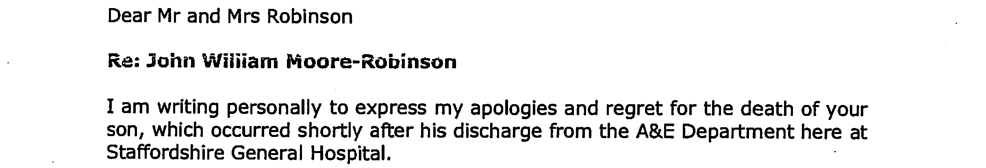
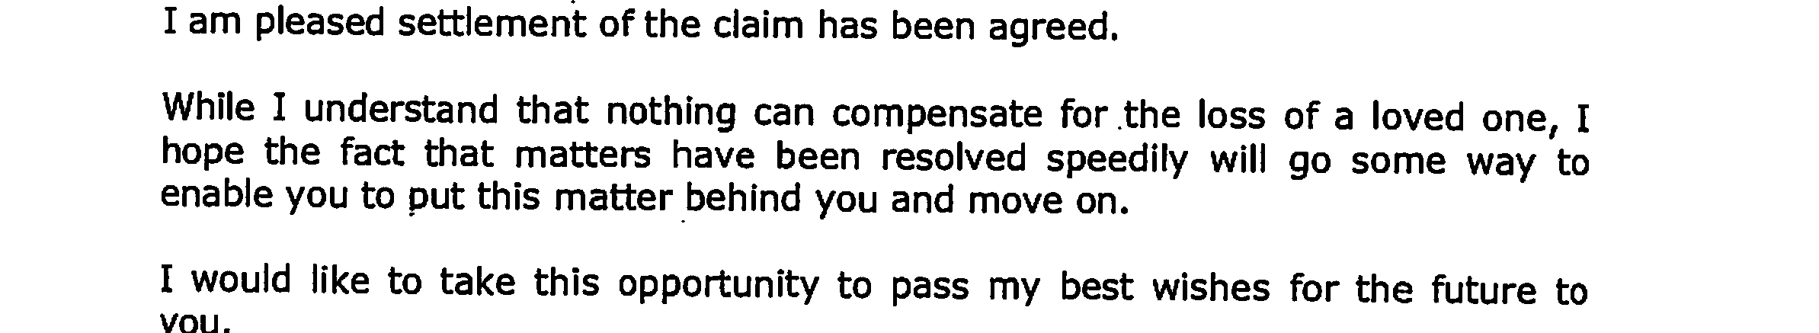
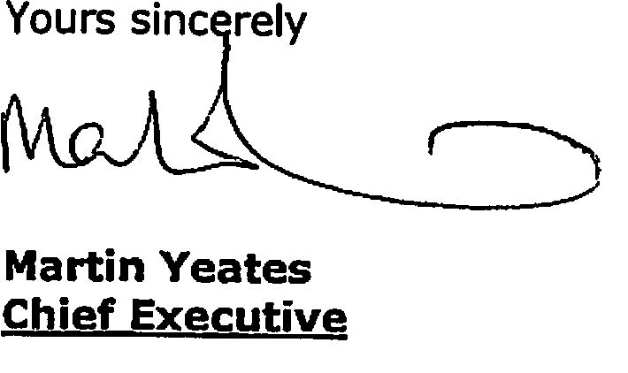
An empathy gap…
Notes:
You may wonder why the duty of candour includes the requirement for an apology. In the case just mentioned, a claim was brought by the parents. NHSLA advised by Trust solicitor “not unreasonable” to view the case as indefensible, but might want to consider obtaining expert report. An offer of damages was accepted and the CEO sent this letter of apology, drafted by the solicitor. It outraged the family who went to the press. The solicitor could not see what was wrong with it. In his explanatory email to the NHSLA he said this:
The apology was the standard NHSLA affair and it was approved by someone … This family have been going on about this and they appeared on telly recently … the apology was given at the express request of the family and [solicitor]. ... we settled very quickly even though there might have been issues that could merit further investigation. I take the view that we treated the family very well … Who is causing a problem and what are they trying to achieve? … Anyway hopefully we can sort this out soon but I suspect the family are having issues (quite understandably) with grief etc. … it is indeed unfortunate that what appears to have been a rapid and well-handled [settlement] by the NHS does not appear to have been appreciated by the family and that they have taken this unfortunate line
You can see why a standard practice with regard to apologies was required.

Slide 32
Leadership self-deception
Birmingham Post 11 Feb 2008
“This is the healthcare equivalent of promotion to the premier league and heralds an exciting new era for our hospitals…
"And today, after a rigorous process to check on our financial stability and our arrangements for ensuring the quality and safety of our healthcare, I am delighted to say 'we did it!'”
[The trust has] “no problem with mortality”
Statement by Director of Nursing to Monitor [regulator]
Dr Helen Moss, Director of Nursing
Mid-Staffordshire NHS Foundation Trust. MSPI report §4.447
Martin Yeates, Chief Executive Mid Staffordshire NHS Foundation Trust
The Board agreed it should be authorised as an NHS Foundation Trust. The Board was concerned about the longer term financial challenges which the Trust may face, the Trust’s failure to deliver the thrombolysis target in the first two quarters of 2007/08 and the A&E standard in December and its current failure to meet its MRSA trajectory. A letter should be sent highlighting Monitor’s concerns in these areas.
Monitor Board minute 30 January 2008: MSPI Report §4.466
Notes:
The pressures incentivize boasting about good news while ignoring the bad

Slide 33
When leaders do not listen
RISK is hidden
DEFICIENCIES not corrected
STAFF demoralised and ineffective
DISASTER follows [personal, reputational and existential]
INJURY TO patients/service users
PURPOSE of organisation not fulfilled
Notes:
The most important quality of a leader or of a collective leadership is the ability to LISTEN and HEAR by which I mean LEARN AND ACT on what is said.
When this does not happen, bad things result

Slide 34
A better way?
Values which prioritise service purpose:
  define with staff so all own them
  follow them personally and insist all doing so
Aim to look like the organisation you want to lead
Candour and transparency
Freedom to Speak Up
Measure what matters

Slide 35
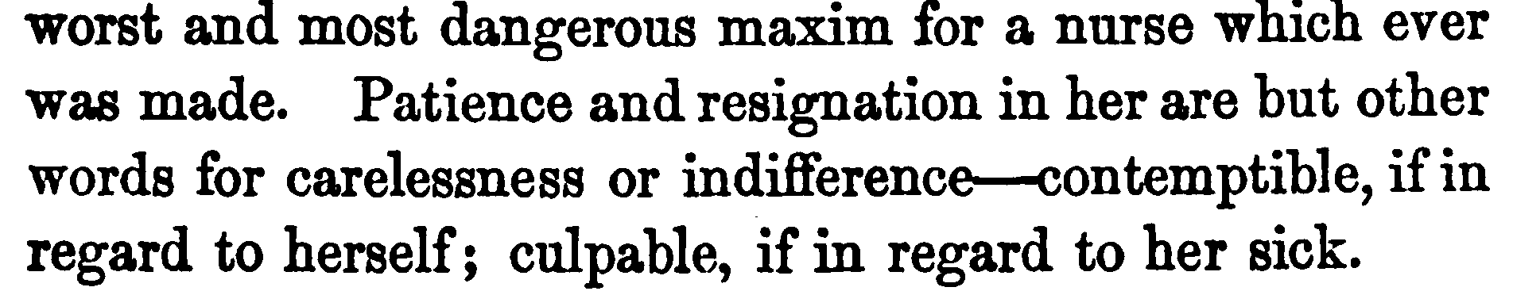
FLORENCE’S VALUES
COMPASSION
COMMITMENT
EXCELLENCE
Florence Nightingale, Notes on Nursing (1860) pages 92-93
Let whoever is in charge keep this simple question in her head (not, how can I always do this right thing myself, but) how can I provide for this right thing to be always done?
― Florence Nightingale, Notes on Nursing: What It Is, and What It Is Not
ENABLEMENT
INSIGHT
Notes:
Florence Nightingale was a great leader
At the battle front hospital, back at home in approaching government
She was a pioneer in evidence based medicine
Had no formal qualifications, went into nursing at a tome when it was not something ladies of the genteel classes did and was a force of nature.
These quotes give an idea why.
She could set out values and missions in inspirational and inconvertible language.
And then go on to get the job done.
Not you will see by doing it all herself, but by getting others to do it

Slide 36
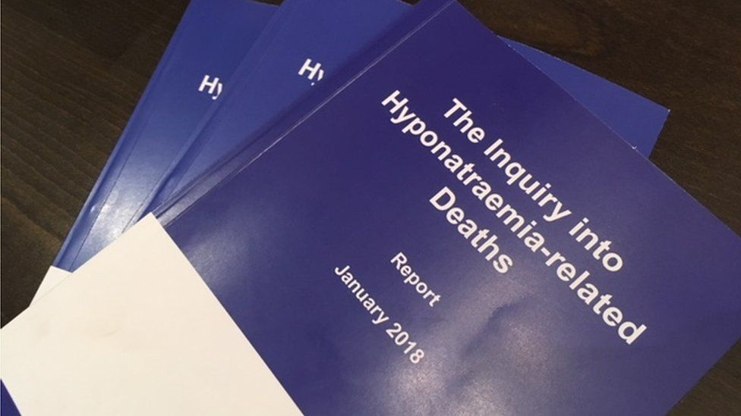
The duty of candour – what has been done?
Act in an open and transparent way with people receiving the service.
Tell anyone who has been harmed by the service , in person, as soon as reasonably practicable after becoming aware the incident, and provide them with support.
Provide an account of the incident which, to the best of the provider’s knowledge, is true, of all the facts known about the incident as at the date of the notification.
Advise the affected person what further enquiries are believed to be needed.
Offer an apology or context appropriate regrets.
Follow up by giving the same information in writing, and providing updates on the enquiries.
Keep a written record of all communications and enquiries.
The failure by senior clinicians to address the issue with appropriate candour suppressed the truth and inhibited proper examination of what had gone wrong. The motivations for this concealment may be multiple, but I count amongst them a determination to protect professional colleagues
from having to confront their clinical errors.
As a result the opportunity to learn lessons was disregarded and critical learning was lost to clinician
Notes:
Following my recommendation a legal duty of candour was introduced via a fundamental standard to be overseen by CQC. This is reinforced by a contractual term in the standard commissioning contract and by professional guidance from the GMC and NMC [laudably produced jointly]]

Slide 37

Freedom to Speak Up Principles
The Public Interest Disclosure (Northern Ireland) Order 1998
Foster a culture of safety and learning in which all staff feel safe to raise concerns
Make raising concerns normal routine business
Remove bullying and oppressive conduct
Welcome and encourage staff to speak up
Show staff they are valued for speaking up and celebrate benefits
Encourage staff reflective practice
Establish facts not blame, with prompt, swift, proportionate fair investigations
Consider mediation/conciliation to resolve disputes
Train staff in raising, receiving and acting on concerns
Offer choice of trusted persons [Guardians] to offer support, advocacy and guidance
Notes:
Looking after the staff includes looking after those who raise concerns. They are the ones who can help put things right when they are wrong.
Report has 16 principles, 10 of which of most relevance outside the NHS.

Slide 38
Some attributes of good leaders – a personal view
Good leaders
role model values
empower all to exercise leadership
promote candour about mistakes
expect staff to speak up about concerns and celebrate those who do
listen to those they serve
act on their concerns and report back to those who raise them
set clear goals in agreement with staff
measure progress including their own
insist on constructive professional development, objective appraisal & reflection
never be satisfied with today’s success, and look for constant quality improvement

Slide 39
Do we need to reverse the pyramid?
Top-down authoritative change is necessary in such a large organisation as the NHS but its success depends on it being driven from the bottom up. –Gbadamoosi, HSJ 30 March 2015
The idea that workers have nothing useful to contribute to management belongs to the 19th century, not the 21st. – Greenham, New Economics Foundation, quoted by Wood, The Guardian 16/1/12
We share the responsibilities and rewards of employee ownership through sharing profit, power and knowledge. By putting Partners first and empowering them, we believe we can better honour our commitment to not only offer our customers quality products and outstanding service but also support the communities and environments we operate within.
John Lewis Partnership Business Model

Slide 40
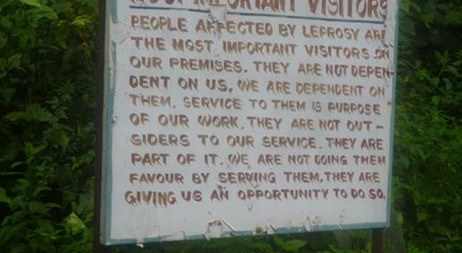
The values should be the same everywhere…

Slide 41
LEARNING FROM INQUIRIES
Reflections from the frontline
QUESTIONS!
Sir Robert Francis KC
Serjeants’ Inn Chambers
London EC4Y 1AE
Notes:
WHAT I WILL TALK ABOUT
WHY ME AND WHY THIS SUBJECT?
LESSONS FOR LEADERSHIP
IMPORTANCE OF VALUES
IMPORTANCE OF CANDOUR AND OPENNESS
FREEDOM TO SPEAK UP FOR STAFF
MEASURING MANAGEMENT

